Slide 1
Recommendations for Similar Cars based on features
And Price Prediction
By Vera Kalinichenko

Slide 2
Understand your Data
Visualize
Extract Information
Formulate Initial Thoughts
Zoom in
Present

Slide 3
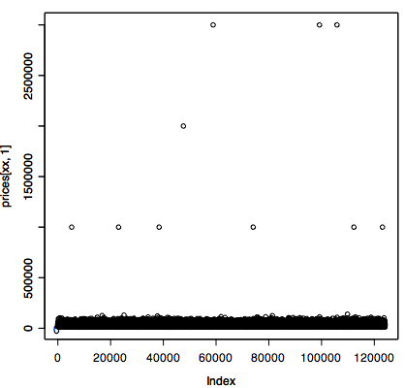
Prices -Plot

Slide 4
Statistics on Prices
Avg Price of Base MSRP is 31255
Avg Price of Trans MSRP is 33118
Mean 32047
Median 31360

Slide 5
Price Column - Outliers
Sort the price column looks at the extremes.
Found that there are 10 rows with prices greater or equal to 1mm

Slide 6
Let’s Observe Data or how to predict price
Formulate the Proposal/ Model/ Look at the Results
Order by large size groups
Regroups Again and Model Again (Iterate)

Slide 7
How to Predict Price?
Create Clusters by grouping the data by year, model_id, door and transmission
Compute average of base_msrp
Compute average of transaction msrp
Subtract base msrp from transaction msrp and divide by 2
Add the above to base msrp

Slide 8
Group data - pricePredictor.pig
Run test_predictor.sh to predict prices for the whole hw 2 set
Run predict.sh to predict prices on the sample subset

Slide 9
How to recommend similar cars?
Create clusters
Locate cluster that contain the given car
Sort the data in the spotted cluster
Return the most relevant 5

Slide 10
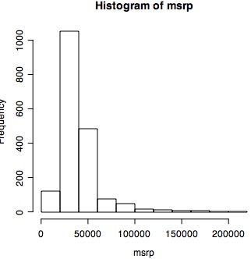
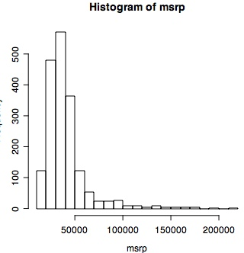
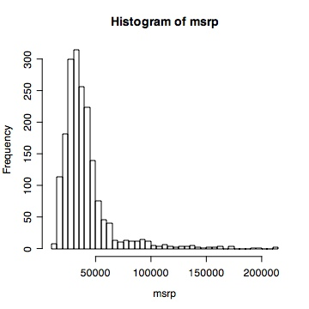
Visualize
Notes:
Need more details, let’s slices into more chucks. Make conclusions based on the visual representation. I used the graph to construct UDF that created price – bucket!

Slide 11
Zoom in Large Size Clusters
MSRP | Size of Grp
40000 | 224
50000 | 174
45000 | 139
22000 | 125
17000 | 77
70000 | 73
20000 | 56

Slide 12
Create Price Buckets – use it
Create clusters based by price buckets
Details in com.sample.pig.PriceClusterUDF

Slide 13
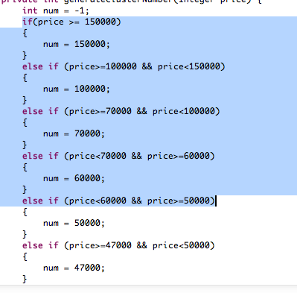
PriceClusterUDF - sample

Slide 14
Blocks - Labels
Range | Actual Label | Size of Cluster
[40000; 45000) | 40000 | 224
[50000; 70000) | 50000 | 174
[45000,40000) | 45000 | 139
[22000,20000) | 22000 | 125
[17000, 15000) | 17000 | 77
[70000, 100000) | 70000 | 73
[20000, 22000) | 20000 | 56

Slide 15
Some Results grouped by msrp only
2012 | BMW | 1 Series | 2dr Coupe 128i | 331732 | Coupe | 32095 | 29600 | 0.04562938 | -1 | 30000 | 314 | 331732
2012 | Ford | Super Duty F-350 DRW | 4WD Reg Cab 137" XL | 335910 | Truck | 34790 | 32441 | 0.06874715 | 227 | 30000 | 314 | 335910
2012 | Ford | Econoline Cargo Van | E-250 Recreational | 335442 | Van | 31350 | 28985 | 0.049706 | 209 | 30000 | 314 | 335442
2012 | Dodge | Challenger | 2dr Coupe R/T Classic | 335849 | Coupe | 30990 | 29770 | 0.03758244 | 13 | 30000 | 314 | 335849
2012 | Ford | Super Duty F-350 SRW | 2WD SuperCab 142" XL | 335921 | Truck | 33235 | 31041 | 0.0691706 | 673 | 30000 | 314 | 335921
2012 | Volkswagen | Golf | 4dr HB DSG TDI w/Tech Pkg | 334382 | Hatchback | 30210 | 29032 | 0.07386765 | 19 | 30000 | 314 | 334382

Slide 16
Let’s try MSRP and body_type
Group | Size | Trim_id
(35000,SUV) | 44 | 334904
(35000,SUV) | 44 | 337073
(35000,SUV) | 44 | 331240
(35000,SUV) | 44 | 334408
(35000,SUV) | 44 | 334410
(35000,SUV) | 44 | 334413
(35000,SUV) | 44 | 334889
(35000,SUV) | 44 | 334892

Slide 17
Results
Data in cl-price-body-type.csv
Outliers – 15 singletons

Slide 18
5 cars similar to trim_id 33041
2012 | Ford | Focus | 4dr Sedan S | 330541 | Sedan | 17295 | 16430
2012 | Nissan | Sentra | 4dr Sedan I4 Manual 2.0 | 336111 | Sedan | 17210 | 16539
2012 | Volkswagen | Jetta Sedan | 4dr Auto Base | 334015 | Sedan | 17385 | 16720
2012 | Ford | Fiesta | 4dr Sedan SEL | 335679 | Sedan | 17395 | 16779
2012 | Volkswagen | Jetta Sedan | 4dr Manual S | 334016 | Sedan | 17415 | 16749

Slide 19
Perhaps - Outliers
2012 | Cadillac | Escalade EXT | AWD 4dr Premium | 331340 | Truck | 70635 | 66108 | 0.05794287 | 1 | (70000,Truck) | 1
2012 | Cadillac | CTS-V Wagon | 5dr Wagon 6.2L | 331824 | Wagon | 64110 | 60001 | 0.06725283 | 1 | (60000,Wagon) | 1
Notes:
Why they are outliers? Only because the cluster size to which they belong is equal to 1..

Slide 20
Questions
AQ

